Slide 1
review
we’ve covered a lot!

Slide 2
Caleb’s Book
http://www.golang-book.com/books/intro

Slide 3
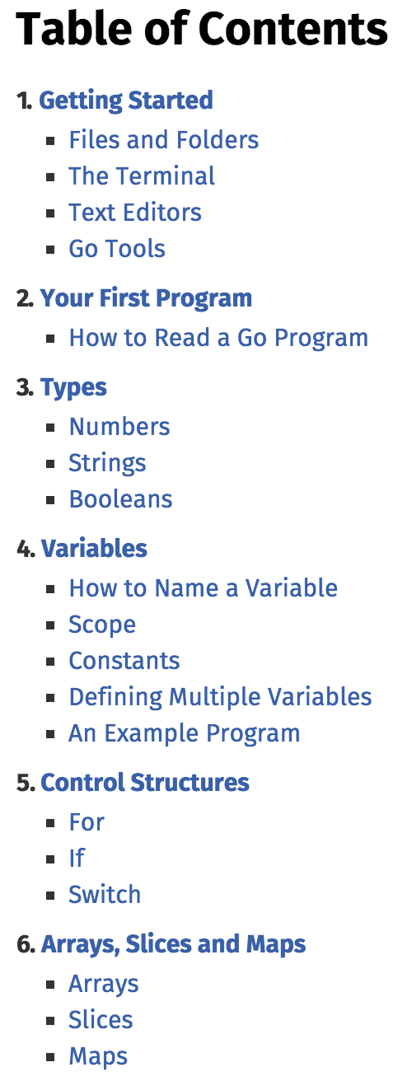
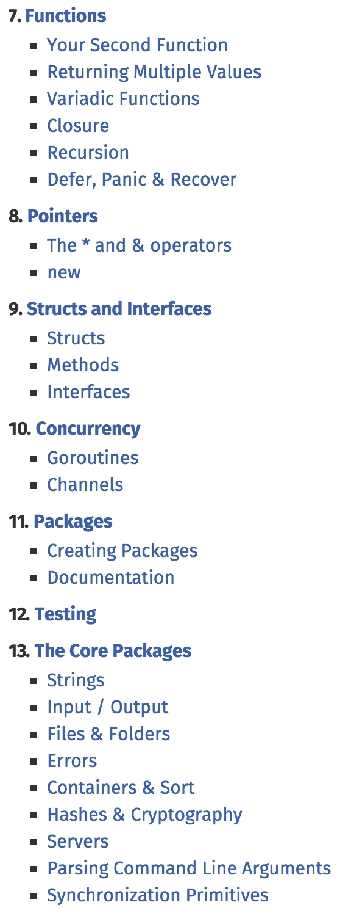

Slide 4
Go By Example
https://gobyexample.com/

Slide 5
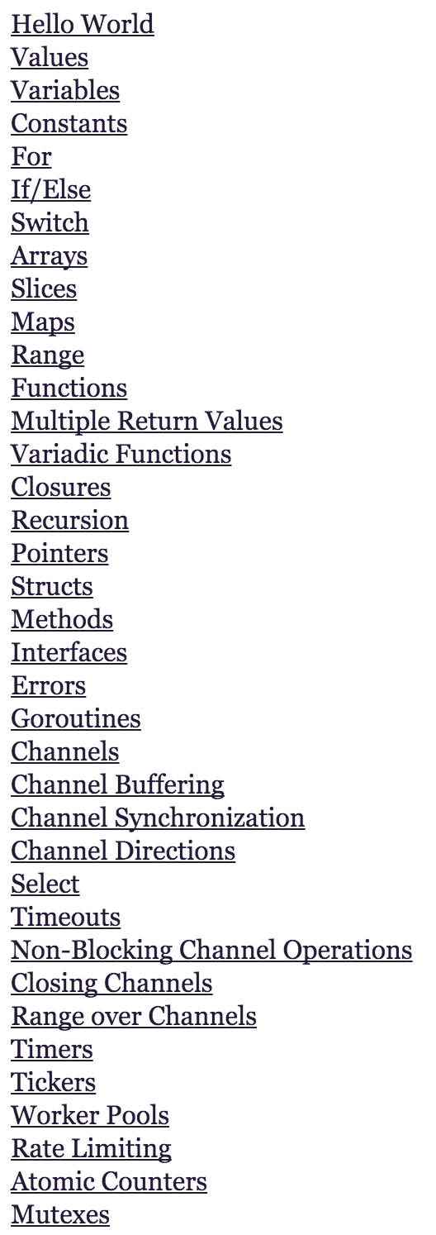
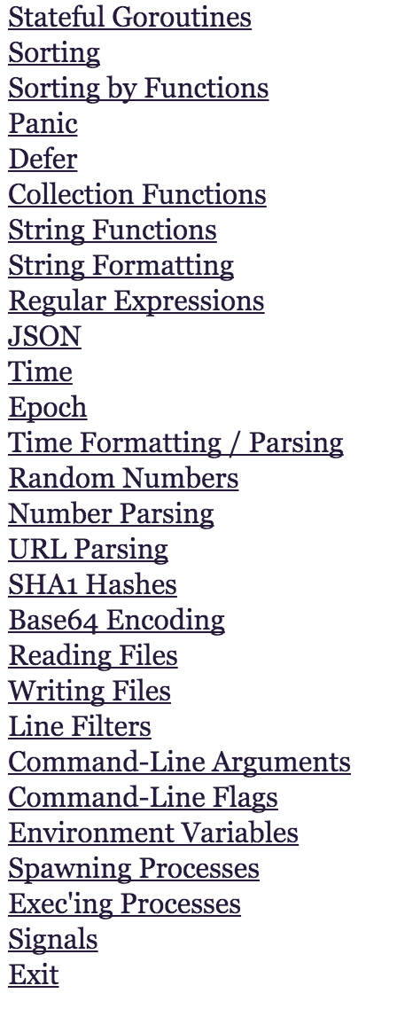

Slide 6
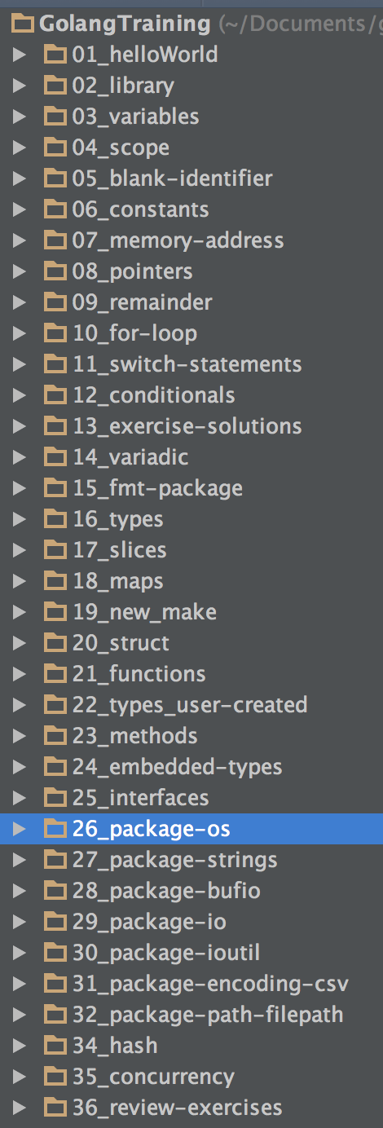

Slide 7
exercises

Slide 8
gravatar
Create a program which
you run from the command line
reads user information (at least name and email) from the command line (os.Args[1])
creates an HTML page
generates a profile image from gravatar.com
gravatar hash
gravatar image
part of your solution should include this code:
h := md5.New() io.WriteString(h, email) finalBytes := h.Sum(nil) finalString := hex.EncodeToString(finalBytes)

Slide 9
word count
create a program that
returns a map of the counts of each “word” in a string. (strings.Fields)
WordCount(“test test”) → map[string]int{ “test”: 2 }

Slide 10
centered average
create a program that
computes the average of a list of numbers, but removes the largest and smallest values.
centeredAverage([]float64{1, 2, 3, 4, 100}) → 3

Slide 11
swap
Write a program that can swap two integers
x := 1 y := 2 swap(&x, &y)
should give you x=2 and y=1

Slide 12
clumps
Say that a "clump" in a list is a series of 2 or more adjacent elements of the same value.
Return the number of clumps in the given list.
countClumps([]int{1, 2, 2, 3, 4, 4}) → 2
countClumps([]int{1, 1, 2, 1, 1}) → 2
countClumps([]int{1, 1, 1, 1, 1}) → 1

Slide 13
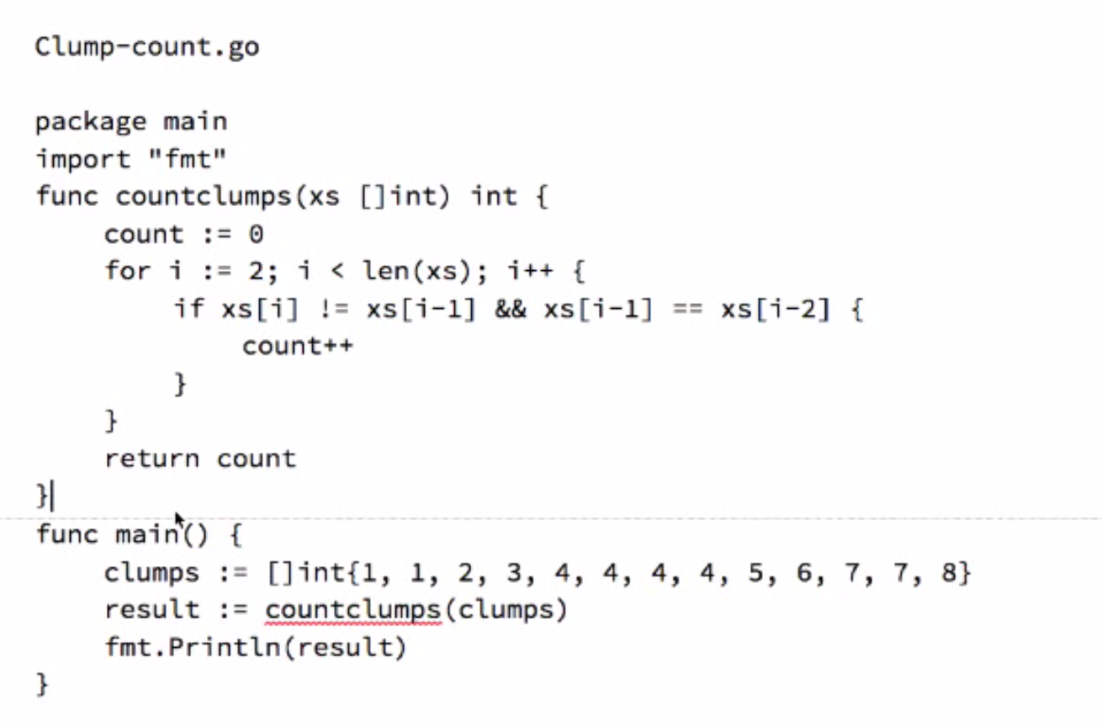
one attempt; has an error though

Slide 14
cat <file>
Create your own version of cat which reads a file and dumps it to stdout.

Slide 15
copy <file>
Create a program which opens a file, reads a file, then writes the contents to a new file.

Slide 16
cp <src file> <dst file>
Create your own version of cp which reads a file and writes it to another file.

Slide 17
unnamed field
Why would you use an embedded anonymous unnamed field instead of a normal named field?

Slide 18
sentence case
Create a program which converts the first character of each line in a file to uppercase and writes it to stdout.

Slide 19
capitalize the first letter of every word
Create a program which capitalizes the first letter of every word from a text file and writes it to stdout.

Slide 20
capitalize every other word
Create a program which capitalizes every other word (capitalizes the entire word) from a text file and writes it to stdout.

Slide 21
count words
Count how many times the word “whale” is used in Herman Melville’s novel, “Moby Dick” (927 pages).
Download “Moby Dick” for free from here: http://www.gutenberg.org/files/2701/old/moby10b.txt
At terminal: curl -O http://www.gutenberg.org/files/2701/old/moby10b.txt

Slide 22
longest word
Find the longest word (string of runes not separated by spaces) used in “Moby Dick”.
Download “Moby Dick” for free from here: http://www.gutenberg.org/files/2701/old/moby10b.txt
At terminal: curl -O http://www.gutenberg.org/files/2701/old/moby10b.txt

Slide 23
cat <files>
Create your own version of cat which reads an unlimited number of file and dumps their contents to stdout.

Slide 24
csv state info
Download a CSV file of state information from statetable.com
implement a program which
parses all of the csv file
prints the following fields for each state:
id int
name string
abbreviation string
censusRegionName string
Make sure to use a struct in your program

Slide 25
csv state info - lookup by state
Download a CSV file of state information from statetable.com
implement a program which
parses all of the csv file
prints the following fields for each state:
id int
name string
abbreviation string
censusRegionName string
Make sure to use a struct in your program
accept a state abbreviation from the user
display only the requested state

Slide 26
csv state info - lookup by state - display html table
Download a CSV file of state information from statetable.com
implement a program which
parses all of the csv file
prints the following fields for each state:
id int
name string
abbreviation string
censusRegionName string
Make sure to use a struct in your program
accept a state abbreviation from the user
write the requested state into an html file

Slide 27
csv stock price
Grab historical financial data from Yahoo as a csv file
http://finance.yahoo.com/q/hp?s=GOOG+Historical+Prices)
read that file
print content from each record to standard out

Slide 28
csv stock price
Grab historical financial data from Yahoo as a csv file
http://finance.yahoo.com/q/hp?s=GOOG+Historical+Prices)
read that file
print content from each record to an html table

Slide 29
checksum a file
Create a program which finds the md5 checksum of a file.
at the terminal
go install
yourProgramName yourFileNameToCheckSum
should return a large hexadecimal number like ‘d47c2bbc28298ca9befdfbc5d3aa4e65’
watch this video for help

Slide 30
checksum a directory of files
Create a program which finds the md5 checksum of all of the files in a directory.
watch this video for help

